Slide 1
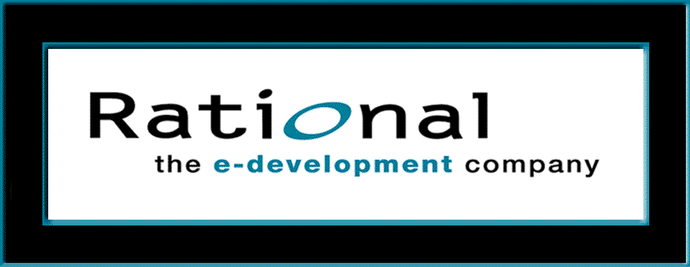
Requirements Management
with Use Cases
Module 9: Requirements Across The Product Lifecycle

Slide 2
RMUC: Course Outline
0 - About This Course
1 - Best Practices of Software Engineering
2 - Introduction to RMUC
3 - Analyze the Problem
4 - Understand Stakeholder Needs
5 - Define the System
6 - Manage the Scope of the System
7 - Refine the System Definition
8 - Manage Changing Requirements
9 - Requirements Across the Product Lifecycle

Slide 3
Requirements Across the Product Lifecycle
Problem
Problem Space
Needs
Solution Space
Features
Traceability
The Product To Be Built
Software
Requirements
Test Procedures
Design
User Docs
Notes:
In this module we will look at how requirements evolve across the product lifecycle.
The iterative process allows us to refine the model in smaller increments at each iteration, and also helps us maintain control of the changes in requirements and use needs throughout the product lifecycle.
Use this slide to explain where we are in the class:
In this module we will look at how requirements evolve across the product lifecycle.

Slide 4
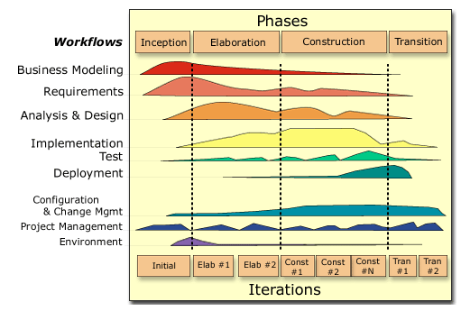
Requirements Across the Product Lifecycle
Requirements
Notes:
The nature of the work performed in the iterations varies greatly across the lifecycle. Early iterations focus on requirements capture and architectural design; in Construction, iterations tend to focus on Design, Implementation, and Test.
Also, the way you perform requirements capture within an iteration may vary depending on where you are in the lifecycle.

Slide 5
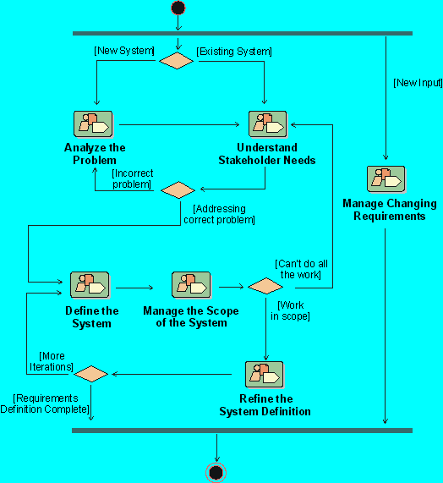
Each Iteration Makes a Pass Through Requirements
Notes:
Each iteration in Rational Unified Process involves one pass through the activities in each of the core workflows, including Requirements.
We will look at the typical state of our requirements at the end of each of the phases of our iterative process.
Where is this done in your own software development process?
If presenting this course on-site at a company not using RUP, discuss the activities they use to accomplish this objective.

Slide 6
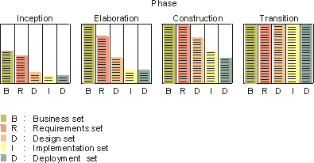
Inception Iterations: Typical Requirements Results
Collect information to develop the business case:
  A draft of a survey of the use-case model
  An initial terminology
  A few use-case flow of events (requirements capture)
  Sketches of user interfaces
  A prototype (optional)
Notes:
The purpose of the Inception phase is to establish the business case for the system and specify the project scope. To accomplish this, you must understand the context of the system, the external entities with which the system will interact, and the nature of that interaction at a high level.
In the Inception phase, the goal of an iteration is to gather enough information to develop the business case.
In a typical example, only one preliminary iteration is performed in the inception phase. No Design, Implementation or Testing follow on the Requirements capture. Typical activities include having the team:
Develop a prototype.
Conduct a requirements workshop, where they discuss some core concepts in their vocabulary, identify an outline of actors and use cases, and briefly described the actors and use cases.
Select a few use cases to develop further. The team defines the flow of events (a very first outline to it) of the prioritized use cases.
Hold an informal review with the project stakeholders to make sure they were on the right track and that there was business case for the project.
Decide on how to take care of all change requests.
The requirements activities vary during the development cycle. In the early part of the project (Inception Phase), the activities on this slide are typical.

Slide 7

Elaboration Iterations: Typical Requirement Results
Refine requirements to build/validate architecture
  Update terminology
  Capture most software requirements
    Use cases and supplementary specifications
  Refine use cases developed in previous iterations
  Decide on use-case view of the architecture
L
U
P
I
D
Notes:
The purpose of the Elaboration phase is to analyze the problem domain, establish a sound architectural foundation, develop the project plan, and eliminate the highest risk elements of the project. To accomplish these objectives, you must have the “mile wide and inch deep” view of the system. Architectural decisions have to be made with an understanding of the whole system: its scope, major functionality, and nonfunctional requirements, such as performance requirements.
In the Elaboration phase, the goals are to refine the requirements and to build and validate an architecture.
Typical requirements capture activities include having the team do the following in the first iteration in the Elaboration phase:
Prioritize use cases (or parts of use cases) to include in this iteration. These decisions are based on a first understanding of the architecture of the system and what use cases would be critical for that architecture.
Write the flow of events for all the prioritized use cases. This is completed in stages: normal flow first and then alternative flows (the ones deemed interesting from an architectural perspective). Review sessions with domain experts are performed.
Review and take care of all change requests. The team also discusses and decides what use cases or parts of use cases to take into Design, Implementation, and Test.
In the next iteration of the Elaboration phase, a similar workflow is followed for requirements capture. Use cases from the previous iteration are then updated, and a new set of use cases are completed. Outstanding change requests are taken care of. The use-case view of the architecture is updated to reflect the changes.

Slide 8
Construction Iterations: Typical Requirement Results
Build the complete system. At this point, requirements should be relatively stable.
  Change requests on use-case’s flow of events
  Updated use-case flow of events
  Emphasis on analysis&design, implementation and test
Notes:
The purpose of the construction phase is to iteratively develop a complete software product that is ready for transition into the user community, starting from a baselined architecture. Thus, the remaining use cases must be completed during this phase, as well as all remaining software implementation and test.
In the construction phase, both requirements and architecture should be stable. The emphasis is on completing use-case descriptions (design) for all use cases, and on design, implementation, and test.
In the Construction phase, the only requirements capture activities that occur are to take care of the change requests and errors that were identified during Design, Implementation, and Test.

Slide 9
Transition Iterations: Typical Requirements Results
Normally, requirements should not change at this late stage of the project.
However, if decisions are made to add new features to the system, an iteration (and produced results) would be similar to a typical construction-phase iteration.
Notes:
The purpose of the transition phase is to transition the software product into the user community. Once the product has been given to the end user, issues usually arise that require you to develop new releases, correct some problems, or finish some of the features that may have been postponed.
Normally, requirements should not change at this late stage of the project.
In the transition phase, the activities performed during an iteration depend on the goal -- fixing bugs, implementation, and test are usually enough. Fixing bugs may involve fixing a problem discovered in the requirements. If new features have to be added, the iteration is similar to the construction phase.

Slide 10
Iteration Assessment
Assess requirements capture results relative to the evaluation criteria established during iteration planning:
  Functionality
  Performance
  Capacity
  Quality measures
Consider external changes that have occurred during this iteration
  Examples: changes to requirements, user needs, competitor’s plans
Determine what rework, if any, is required and assign it to the remaining iterations
Notes:
Each iteration is concluded by an iteration assessment where the development organization pauses and reflects on what has happened, what was achieved or not (and why), and uses the lessons learned to improve the organization and the process for future iterations.
For this iteration assessment, you assess the results of the iteration relative to the evaluation criteria that were established in the iteration plan: functionality, performance, capacity, quality measures.
This is a critical step in making the iterative approach successful. If this is not done properly, the benefits of the iterative approach will be lessened.
Also, remember that at times the right thing to do in this step is to revise the evaluation criteria rather than reworking the system. Sometimes, the benefit of the iteration is in revealing that a particular requirement is not important, or is too expensive to implement, or creates an architecture that cannot be maintained. In these cases, a cost/benefit capture must be done. This is a business decision.

Slide 11
Reviewing Requirements
Informal reviews
  To find errors
  Whenever needed
  Small team, possibly including QA
Formal reviews
  To decide whether to proceed to next phase
  At milestones and tollgates
  Large reviewing team, including customers
Notes:
All new and changed requirements (use cases) need to be reviewed by a review group.
There are both formal and informal reviews.
The main differences between formal and informal reviews are the purpose and timing of the review.
Informal reviews can be done any time you need another pair of eyes to look at what you are working on. The purpose is primarily to find errors.
Formal reviews are done at major decision points in the project. These decision points are called milestones. A “tollgate” is a milestone with financial decisions to be made. For example, at the end of the inception phase, there is a milestone in RUP called the "Lifecycle Objectives Milestone". At this point, you examine the lifecycle objectives of the project, and decide either to proceed with the project or to cancel it. The decision to fund/not fund the remainder of the project is a tollgate.

Slide 12
Types of Reviews
  Walkthrough
  Inspection
  Formal Review
Less Formal
More Formal
IEEE, 1994
Notes:
As you progress through the development lifecycle, the reviews will become more and more formal until the final formal is accepted.
IEEE defines 3 types of reviews of different levels of formality and ceremony.

Slide 13
Reviewing Requirements: Walkthrough
Purpose
  Find errors in an early stage
  Find deviations from approved style, technique, standards
  Informing
Participants
  A few project members, need not be prepared
Procedure
  Analyst gives an overview of the results
  Analyst walks through reviewed chapters, other participants comment
  Analyst makes notes on errors found
Notes:
Walkthroughs are the least formal.
We talked about this during the elicitation techniques section when we discussed doing a walkthrough of a customer-generated spec.

Slide 14
Reviewing Requirements: Formal Review
Purpose
  To ensure that results are complete and consistent
  To decide on continuation of project
Participants
  Top management, project leaders, process owners, analysts
Procedure
  Check status of documents (evaluation results)
  Review outcome of the project
  Authorize start of next phase
Notes:
This is the most formal type of review.
This is usually done at formal checkpoints during the project, and at the final review and acceptance point for a release to the customer.

Slide 15
Reviewing Requirements: Inspection
Purpose
  To get views from different parts of the organization
  To become aware of each other’s views
  To find errors and problems early
    Problems surfacing at the end may kill the project!
  To decide whether the reviewed document should be
    Approved, approved with corrections, or rejected
Participants
  Moderator
  Recorder
  Author
  Inspectors
Notes:
Inspections are more formal than walkthroughs and are used to gain information as well as to find problems or errors.

Slide 16
Who Should be Inspectors?
Users of the system
Members of departments using the new system
  Representatives of all departments using new system
  Not just those that are involved in this use case
Process owners
Managers of the users
Domain experts
Designers of the system
Notes:
The role that the different groups are playing during the inspection depends on who wrote the use case (or other requirements document).
If this was done by a specific analysis team familiar with the problem domain, then the designers are an important inspector group.
On the other hand, if the designers wrote the use cases, then it would be very important to include the inspectors from the domain expertise.

Slide 17
How to Organize an Inspection
Before the meeting - At least 1 week in advance
  Invite Inspectors (Hint: < 8)
  Distribute materials to review (Hint: < 50 pages)
  Distribute instructions and questions
  Have inspectors read materials and write comments
At the meeting
  Moderator leads and keeps meeting focused
    Keep the meeting short and fast (Hint: < 2 hours)
  Recorder records all issues
  Inspectors look for and discuss errors
    Objective is to find problems - not to solve them
    Handle spelling/typographical errors outside the meeting
Notes:
Why is it important that the inspectors write their comments ahead of time?
Why is it important that the inspectors have written their comments?
It is the only way for the moderator to see if they have done their homework!
Too often it happens that some inspector has not read the paper and tries to read it during the inspection meeting. That attitude does not work - to inspect something you have to read it in advance and decide the issues to discuss.

Slide 18
Results of an Inspection
Major Problems
  Severe problem: a section has to be reworked
  Use case can’t be approved: a new inspection is required
Minor Problems
  Things that can be fixed
  Approval of use case may be delegated to moderator
Recommendations
  Give concrete, constructive suggestions for improvements
  Avoid too general comments like “bad” or “unclear”
  Do not focus only on the negative, note positives too
Notes:
Minor remarks do not usually require a new inspection. It is normal that minor corrections be approved by the moderator, etc.

Slide 19
Review Questions For The Use-Case Model
Is the use-case model understandable?
By studying the use-case model, do you understand the system's functions and how they are related?
Have all functional requirements been met?
Does the use-case model contain any superfluous behavior?
Is the division of the model into use-case packages appropriate?
Is it worth the money to build the system?
Notes:
Here are some checkpoints to assist you when you review your use-case model for accuracy and completeness. The instructions to inspectors should contain questions from your checklists.
Complete checklists are provided in the Rational Unified Process.
A normal system has 20 to 50 use cases. A very large system has no more than 100 use cases.
The number of use cases is more a measure of the complexity of the interaction between the system and actors. A big, but simple, system may have a few use cases, but a small system (that may be complex to build) may have lots of use cases.
The number of use cases a project may initially identify may be large (because they are doing functional decomposition) The idea of fewer use cases helps to push them towards the real usage of use cases - thinking of functionality rather than algorithms when doing functional requirements analysis.
After you are finished with your use-case model, you should review the model for accuracy and completeness. The above, as well as the following checklists, are useful questions when reviewing the use-case model. Explicit, detailed checklists should be established for the project to support the review of the use-case model. The instructions to inspectors should contain questions from your checklists.
Verify that there are no open questions. The use cases you have found must be able to perform all system behaviors; if not, some use cases may be missing. Make sure all requirements are covered, either in the use cases or in declarative statements in the Supplementary Specifications.
Traceability from the original requirements to the use cases and the Supplementary Specification is critical for project management, impact assessment and to make sure nothing has been missed
The packaging should make the use-case model more simple and intuitive to understand and maintain.

Slide 20
Review Questions For Actors
Have all the actors been identified?
Is each actor involved with at least one use case?
Is each actor really a role? Should any be merged or split?
Do two actors play the same role in relation to a use case?
Do the actors have intuitive and descriptive names? Can both users and customers understand the names?
Notes:
Make sure that all the roles in the system's environment have been accounted for and modeled. You can check this at this point, but you cannot be sure until you have found and described all the use cases.
Remove any actors not mentioned in the use-case descriptions, or any actors without communicates-associations with a use case. However, an actor mentioned in a use-case description is likely to have a communicates-association with that particular use case.
You should be able to name at least two people who would be able to perform as a particular actor. If not, check if the role the actor models is part of another role. If so, you should merge the actor with another actor. If any actors play similar roles in relation to the system, they should be merged into into a single actor. If a particular actor will use the system in several completely different ways, or has several completely different purposes for using the use case, then there should probably be more than one actor.
If two actors play the same role in relation to a use case, then actor-generalizations should be used to model their shared behavior.
It is important that actor names correspond to their roles.

Slide 21
Review Questions For Use Cases
Name and brief description
  Is it clear which actor wishes to do the use case?
  Is the purpose of the use case also clear?
  Does the use case have a unique and intuitive name so that it cannot be mixed up with others?
Flows of events
  Are the flows (basic and alternative) accurate?
  Is it clear how and when each flow of events starts and ends?
  Are actor interactions and exchanged information clear?
  Does the communication sequence between actor and use-case conform to the user's expectations?
Notes:
Use case specifications should be clear, complete and accurate.

Slide 22
Review Questions For Use Cases (Continued)
  Does the use case deliver a result of value?
  Do you understand how the result of value is achieved?
  Is this a good way to do it?
  Is there a better way to do it?
  Is anything missing?
  Is the use case overly complex?
  Is the use case independent of the others?
  Do any use cases have very similar behaviors or flows of events?
Notes:
Each use-case name must describe the behavior the use-case supports. The name, description, flow of events and other specifications must be understood be the users, customers and developers.
A use-case that does not deliver value to an actor probably belongs as a part of a larger use case, and you should combine them.
If you want your use-case model to be easy to understand, you might have to split up complex use cases. A use-case that contains disparate flows of events will be very difficult to understand and to maintain. It is best to divide such use cases into two or more separate use cases.
If two use cases are always activated in the same sequence, you should probably merge them into one use case. Use cases that have very similar behaviors or flows of events, or if you wish their behavior to be similar in the future, should be merged into a single use case. This makes it easier to introduce future changes.
You must involve the users if you decide to merge use cases, because the users, who interact with the new, merged use-case will probably be affected. If some part of the flow of events is already part of another use case, the subflow should be extracted and be used by the use cases in question. You must involve the users if you decide to "reuse" the subflow, because the users of the existing use-case will probably be affected.

Slide 23
Exercise: Review the Use-Case Model
Review the current state of the use-case model of one of the groups in the class
  What type of review would be appropriate at this point in time?
Notes:
RECOMMENDED:
Whole-class or group exercise.
Estimated time: 5-30 minutes.
Probably, this exercise will be skipped due to time constraints.
You can refer back to the reviews that we have been doing at the end of each of the previous exercises.
Might just want to have a discussion on the type of review that would be done at the early stages of the project (such as where we are now with our class project)
Probably a walkthrough is most appropriate, especially since we do not have a formal set of requirements against which to compare our current model.

Slide 24
Review: Requirements Across the Product Lifecycle
1. What is the typical state of a use-case model at end of
  The Inception phase?
  The Elaboration phase?
  The Construction phase?
  The Transition phase?
2. Under what circumstances would you change anything in the use-case model during the Transition phase?
3. What is the purpose and contents of an iteration assessment?
4. What are the different types of reviews? When might each be used?
Notes:
Use these questions to monitor the students’ level of understanding and to help them review.
Tell them they can look back through the material to get the answers.
Give them time to answer. Don’t be afraid to stand quietly while they look up the answer.

Slide 25
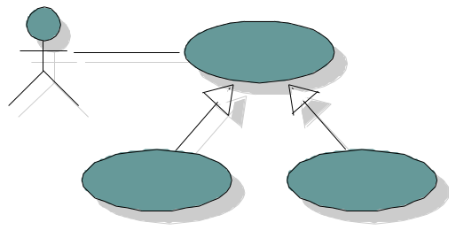
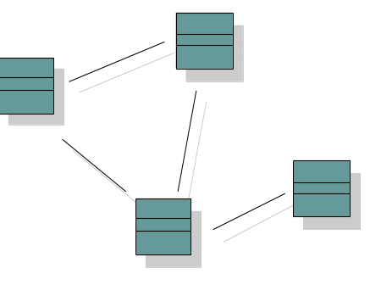
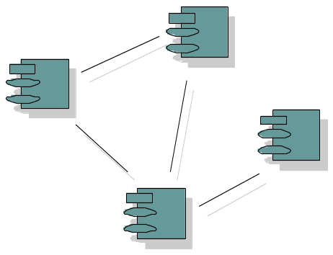
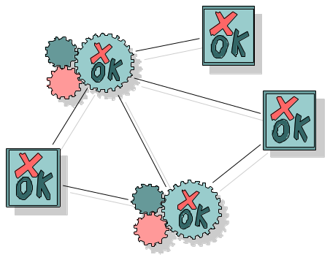
How Do Requirements Drive Development?
Use-Case Model
Realized by
Implemented by
Verified by
Design Model
Implementation Model
Test Model
Notes:
Now that we have finished and reviewed the requirements specifications, where do we go from here? Let’s take a brief look at how they are used in the rest of the development of the system to be built.
Use-Case Driven: The Use cases serve as a unifying thread throughout system development
The same use-case model is used in requirements, analysis & design, implementation and test.
Use cases defined for a system are the basis for the entire development process. They provide the unifying thread through the system and define the behavior performed by a system. Use cases play a role in each of the core process workflows:
The use-case model is a result of the requirements workflow. In this early process you need the use cases to model what the system should do from the user's point of view.
In analysis and design use-cases are realized in a design model. You create use-case realizations which describe how the use-case is performed in terms of interacting objects in the design model. This model describes, in terms of design objects, the different parts of the implemented system, and how the parts should interact to perform the use cases.
During implementation the design model is the implementation specification. Because use cases are the basis for the design model, they are implemented in terms of design classes.
During test the use cases constitute basis for identifying test cases and test procedures. The system is verified by performing each use case.
Use cases have other roles as well:
Basis for planning an iterative development.
Foundation for what is described in user manuals.
Definition of ordering units. For example, a customer can get a system configured with a particular mix of use cases.

Slide 26
Requirements Drive Design and Implementation
Analysis
and Design
Use Cases
Develop model
of requirements
Add detail and
design decisions
User’s Perspective
Developer’s Perspective
Notes:
Let’s look at how we use the requirements in the early stages of design.
Highlight the idea that Analysis and Design transforms requirements into a design, which is then later implemented.
This section previews Use-Case Analysis, as taught in the Object Oriented Analysis and Design (OOAD) course. We’ll give a quick look at a few of these activities, so that students of requirements management will have some idea of what happens to the requirements after the requirements workflow is completed.
The Requirements workflow provides the primary input for Analysis and Design: Use-Case Model, Glossary, and Supplementary Specification. The Analysis and Design workflow transforms the requirements into a design of the system to-be.
The result of Analysis and Design is a Design Model that is the "blueprint" of how the executable source code is structured and written. The Design Model consists of design classes structured into design packages; it also contains descriptions of how objects of these design classes collaborate to perform use cases (use-case realizations).
Use-case descriptions read like a ‘black-box’ description, in which internal details on what the system does in response to an actor’s actions is missing. To find the objects which perform the use case, you need to have the ‘white box’ description of what the system does from an internal perspective.
The examples on the following pages show the kinds of activities in the Analysis and Design process and the kinds of diagrams that are created. Our intent is to illustrate how use cases from the Requirements workflow are used in Analysis and Design. If you want to learn more, the Object-Oriented Analysis and Design (OOAD) course teaches how to the process of Analysis and Design.

Slide 27
Analysis/Design Adds Information To Use Cases
The system retrieves and displays a list of current transaction offerings from the ATM database.
The system displays a list of transaction offerings.
Notes:
During Analysis and Design, additional details are added to each use case. Additional information is needed in order to understand the required internal behavior of the system that may be missing from the use-case description written for the customer of the system.
During Analysis and Design, additional details are added to each use case. Additional information is needed in order to understand the required internal behavior of the system that may be missing from the use-case description written for the customer of the system. This information will be used as input to the rest of the steps in Use-Case Analysis and is used to assist in the allocation of responsibility.
For example, in the ATM System, the Withdraw Cash use case may say ”The system displays a list of transaction offerings” (withdraw, deposit, etc.). While this may be sufficient for the user, it gives no real idea of what really happens inside the system. The expanded description would say: "The system retrieves and displays a list of current transaction offerings from the ATM database.” This level of detail gives us a clear idea of what information is required and where the information will be obtained.
Note: In some cases, we may find that some requirements were incorrect or not well-understood. In those cases, the original use-case flows of events should be updated. That is, you may have to iterate back to the Requirements workflow to correct the use case.

Slide 28
Analysis/Design Defines Classes
Bank Customer
Withdraw Cash
Bank Consortium
<<boundary>>
Card Reader
<<boundary>>
Bank Interface
Notes:
The path to executable code starts by defining the candidate (“analysis”) classes, based on the use cases. The candidate classes, taken together, represent an early conceptual model of the system. This conceptual model evolves quickly and remains fluid for some time as different representations and their implications are explored. The final design model represents the stable set of classes that will be developed into executable code.
Three different perspectives of the use cases in the system requirements drive the identification of candidate classes. The three perspectives are
The boundary between the system and its actors
The information the system uses
The control logic of the system.
The above example shows 2 candidate boundary classes for user interfaces.
The path to executable code starts by defining the analysis classes, based on the use cases. The example shows classes for the user interfaces.

Slide 29
Analysis/Design Defines Interactions Among Classes
For each use-case flow of events, show interactions in interaction diagrams
Collaboration Diagrams
Sequence Diagrams
Use Case
Use-Case Realization
Handout
UC7: UC
Collaboration Diagram
Notes:
Interaction diagrams help determine if you have allocated all use-case behavior to classes.
UC7 is an example of collaboration diagrams, for the Withdraw Cash Use Case. They are reproduced in the next two pages.
You can identify classes responsible for the required behavior by stepping through the flow of events of the use case. After identifying classes, it’s time to see exactly where they are applied in the use-case flow of events.
A use-case realization describes how a particular use case is realized within the design model, in terms of collaborating objects. A use-case realization ties together the use cases from the use-case model with the classes and relationships of the design model. A use-case realization specifies what classes must be built to implement each use case.
Within the UML, the analysis and design are represented using a set of diagrams which model: the classes/objects that implement the use case and their relationships -- class diagrams; and how these classes/objects interact to perform the use cases -- collaboration and sequence diagrams.
Interaction diagrams show interactions of the system with its actors. Most of the flows of events for each use case are modeled to make sure that all requirements are handled by operations of the participating classes.
The number and types of the diagrams that are used depend on what is needed to provide a complete picture of the collaboration and the guidelines developed for the project under development.

Slide 30
Example: Withdraw Cash UC Sequence Diagram
: Card Reader
: Card Trans
: PIN request
: Menu
: Money in ATM
: Withdraw Tran
: Money dispenser
: Select amount
: Bank interface
: log
: Receipt Printer
New card, card id
s
request PIN code
Check available money, kind of bills
Display possible selections
Withdraw selected
Start withdraw
Check bills
Ask for amount
Ask for account
Log Start of trans
Send
OK to dispense
Log
Eject card
Dispense Money
Money ejected
Print receipt
Notes:
A sequence diagram describes a pattern of interaction among objects, arranged in a chronological order; it shows the objects participating in the interaction and the messages they send.
Briefly walk through this interaction diagram, emphasizing how the sequence diagram shows what happens in a scenario of a use case.

Slide 31
Example: Withdraw Cash UC Collaboration Diagram
Knows the amount
of each kind of
: PIN request
bill
: Menu
The Customer inserts the
4: Display possible selections
i card in the card reader
2: request PIN code
5: Withdraw selected
1: New card, card id
3: Check available money, kind of bills
: Card Reader
: Card Trans
: Money in ATM
6: Start withdraw
7: Check bills
14: Eject card
11: Send
9: Ask for account
: Select amount
8: Ask for amount
12: OK to dispense
: Bank interface
: Withdraw Tran
s
13: Log OK
10: Log Start of trans
The bank withdraws
17: Print receipt
immediately the
money from the
account
15: Dispense Money
: Receipt Printer
16: Money ejected
: log
: Money dispenser
Notes:
A collaboration diagram describes the same pattern of interaction among objects as in a sequence diagram. In a sequence diagram, the interactions are arranged in a chronological order. In a collaboration diagram, the interactions are shown in a way that emphasizes which classes interact with which other classes.
Both sequence diagrams and collaboration diagrams help the designers see if the classes they are designing have the functionality to be able to perform the scenarios of each use case. This helps to ensure that the design is a blueprint for building the right system.
Briefly walk through this interaction diagram, emphasizing which actor interacts with what classes.
The design model should contain classes that meet the functional requirements made on the system. The classes and their relationships are consistent with the use case scenarios they support.
This concludes the section on how requirements drive the design process. Summarize how use cases drive the analysis and design. Be sure to tie it back to the use-case model

Slide 32
Requirements Drive Test
Use Cases
Test
Develop model
of requirements
Add detail and
test case decisions
User’s Perspective
Tester’s Perspective
Notes:
Let’s look at how we use the requirements in the early stages of testing.
Highlight the idea that the Test workflow transforms requirements into a test cases.
This section previews the Design Tests activity, as taught in the Principles of Functional Testing (PFT) course. We’ll give a quick look at a few of these activities, so that students of requirements management will have some idea of what happens to the requirements after the requirements workflow is completed.
What do we want to test for after the design for a system is implemented into executable code? We want to test to make sure it does what the requirements say it should do!
The Requirements workflow provides the primary input for “black-box” (from the external perspective of the system) testing. Use-cases provide a ‘black-box’ description of what the system does in response to an actor’s actions. So, a test case consists of running through the use case and seeing if the desired result is obtained. The Test workflow transforms the requirements into a test cases, which can then be transformed into test scripts for automated testing.
The examples on the following pages show examples of how scenarios of a use case become test cases. Our intent is to illustrate how use cases from the Requirements workflow are used in Test.
If you want to learn more, the Principles of Functional Testing (PFT) course teaches the process of testing.

Slide 33
Scenario 1: Normal Flow
Withdraw
Insert card
Read card
Enter PIN
Select transaction type
Enter account
Enter withdraw amount
Check cash in ATM
Ask bank for authorization
Give money and receipt
Take money, receipt,
and card
Bank Customer
Notes:
Review this slide with the participants.
For a cash withdrawal to be successful, you need:
A valid card
A valid account
A valid PIN number
Money in the ATM
Money in the account
Bank system can communicate with ATM
Bank will authorize
This list represents the normal flow of events as the actor performs a withdrawal from an ATM.
Following the use case scenario, the tester should identify and list the steps taken by the actor. These actions identify the prerequisites and data needed to execute the use case.

Slide 34
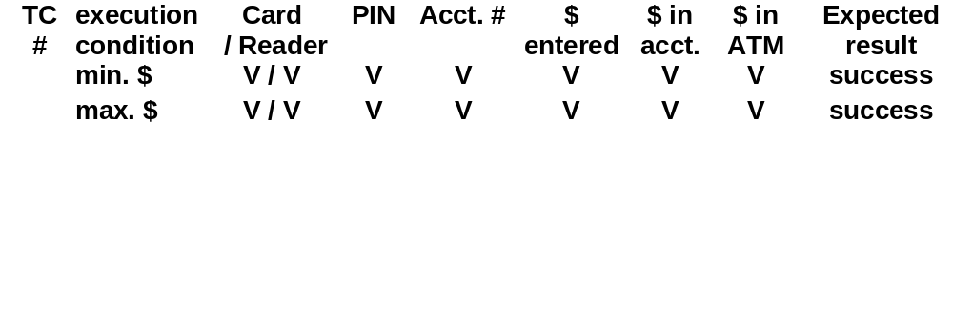
Test Cases For Scenario 1
Use Case: Cash Withdrawal
Test Type - Business Function
Test Parameters
Notes:
Emphasize that there are only two successful test cases listed here.
Ask the participants if they can identify other normal test conditions.
Test cases identify test parameters, execution conditions, and expected results.
Test parameters and conditions are:
A bank or credit card, accepted by ATM and bank network, readable by the ATM card reader
A valid PIN associated with the card and account number
A valid bank account number
A valid withdrawal amount entered
Sufficient money in the account and in the ATM to complete the transaction
The expected results include:
Withdraw the minimum amount successfully
Withdraw the maximum amount successfully

Slide 35
Scenario 2: Alternative Flow
Insufficient Cash in ATM
Insert card
Read card
Enter PIN
Select transaction type
Enter account
Enter withdraw amount
Verify cash amount in ATM
Warning message given
Press cancel
ATM returns to select
transaction type prompt
Withdraw
Bank Customer
Notes:
This slide represents scenario 2, an alternative flow - insufficient cash in the ATM to dispense the requested amount.
Emphasize that the first few steps are the same as in the normal flow.
Before advancing to the next slide, ask the participants to state the parameters, execution conditions and expected result for a test case to verify this alternative flow.
There are several execution conditions:
1. Bank customer enters an amount smaller than the smallest cash denomination available in the ATM.
2. Bank customer enters an amount that cannot be created with the cash denominations in the ATM.
3. Bank customer enters a decimal value.
This slide depicts scenario 2, an alternative flow, i.e., insufficient cash in the ATM to complete the transaction. Notice that the first few steps are the same as in the normal flow.

Slide 36
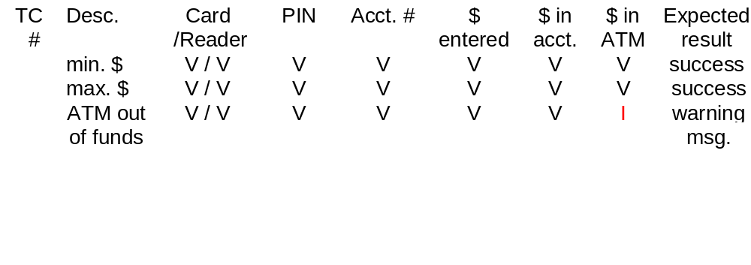
Test Cases For Scenario 2: Alternative Flow
Use Case: Cash Withdrawal
Test Type - Business Function
Handout
UC 6: Withdraw Cash Tests Cases
TP8:Test Plan Template
Notes:
Emphasize that in this test case, only one test parameter is different from the normal flow max. and min. test cases – insufficient money in the ATM.
Also emphasize that requirements should trace to the tests which test them. Have the students turn to UC6 and look at the full sample test specification for the Withdraw Cash Use Case in the ATM example. Point out how the use-case approach makes the testing easy, because the tests just go through the steps of the use case. Each row of the test specification is a different test case. Each column of the test specification is a input during the use case. Each row has a different set of inputs for the use case. For example, one test case has a valid PIN, and another test case has an invalid PIN.
Finally, note that there is a template for the Test Requirement Specification in the TP section.
Notice that in this alternative flow test case—insufficient cash in the ATM to complete the transaction—all of the test inputs and execution conditions are the same as for the normal flow, except the amount of money in the ATM.
Look at the (ATM) Sample Test Case (Handout UC6) matrix that outlines the many different scenarios of the Withdraw Cash use case. Each of the different variants should be tested.
There is also a sample Test Requirement Specification in the “Sample Document Templates” section of your handouts.

Slide 37
RMUC: Summary
Build the right system right by following a process to define and manage requirements to meet the customer’s real needs
Effective problem analysis will help avoid the “Yes, but…”
Elicitation helps you understand your stakeholders’ needs
Use features and a use-case model to come to an agreement with the customer on the definition of the system
Increase your chances to deliver on time and on budget by managing scope throughout the lifecycle of the project
A use-case model of the software requirements helps refine the system definition to drive design, test, and user documentation
Requirement attributes and traceability help you manage change and avoid “scope creep”
Notes:
Summarize each of the key skills that we emphasized throughout the course.

Slide 38
Applying RMUC Concepts: Handouts
Summary: Key Skills for Requirements Management
White Paper: Applying Requirements Management with Use Cases
Handout
WP3
WP4
Notes:
Point out the white paper Key Skills for RM at the end of the Student Handouts.
It is a very useful summary sheet to help them keep track of where they are in their process and to make sure they are covering all the items.
The white paper Applying Requirements Management with Use Cases in the Student Handouts contains additional helpful information.

Slide 39
Why Are We Here?
The GOAL is to deliver
quality products
on time and on budget
which meet the customer’s
real needs.
Notes:
What did we learn that might help us meet this goal?
Go back to the student needs elicited during the first exercise (you should have these posted on the wall somewhere).
Go through each one and ask, “How many of you wanted this?” “What did you learn that might apply to meeting this need?”

